Slide 1
On the Application of Formal Principles to Life Science Data:
A Case Study in the Gene Ontology
Barry Smith *
Jacob Köhler †
Anand Kumar *
* http://ifomis.de
† http://cweb.uni-bielefeld.de/agbi/

Slide 2
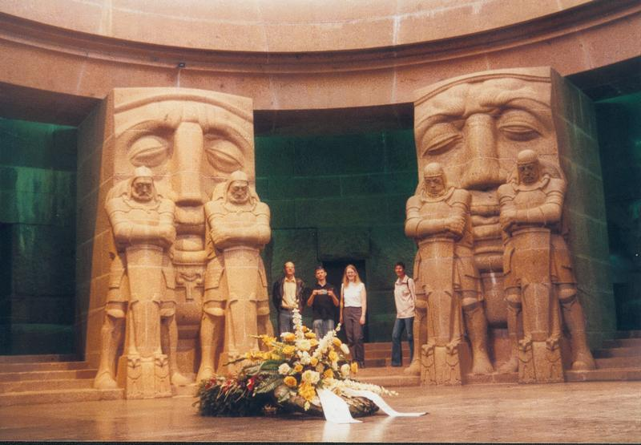
Part One
Survey of GO

Slide 3
GO is a ‘controlled vocabulary’
designed to standardize annotation of genes

Slide 4
GO very successful
used by over 20 genome database and many other groups in academia and industry
and methodology much imitated

Slide 5
GO here an example
of the sorts of problems confronting life science data integration
of the degree to which philosophy and logic are relevant to the solution of these problems

Slide 6
GO three large telephone directories
of terms used in annotating genes and gene products

Slide 7
When a gene is identified
three important types of questions need to be addressed:
1. Where is it located in the cell?
2. What functions does it have on the molecular level?
3. To what biological processes do these functions contribute?

Slide 8
GO’s three ontologies:
cellular components
molecular functions
biological processes
March 15, 2004:
1395 component terms
7291 function terms
8479 process terms

Slide 9
Cellular Component Ontology
flagellum
chromosome
membrane
cell wall
nucleus
(counterpart of anatomy)

Slide 10
Molecular Function Ontology
ice nucleation
protein stabilization
kinase activity
binding

Slide 11
Biological Process Ontology
glycolysis
death
adult walking behavior

Slide 12
Part Two
GO as ‘Controlled Vocabulary’

Slide 13
Principle of Univocity
terms should have the same meanings (and thus point to the same referents) on every occasion of use

Slide 14
Principle of Compositionality
The meanings of compound terms should be determined
1. by the meanings of component terms
together with
2. the rules governing syntax

Slide 15
The story of ‘/’

Slide 16
/
GO:0005954 calcium/calmodulin-dependent protein kinase complex
=Df An enzyme that catalyzes the phosphorylation of a protein; it requires calmodulin and calcium.

Slide 17
/
GO:0001539 ciliary/flagellar motility
=df Locomotion due to movement of cilia or flagella.

Slide 18
/
GO:0045798 negative regulation of chromatin assembly/disassembly
=df Any process that stops, prevents or reduces the rate of chromatin assembly and/or disassembly

Slide 19
/
GO:0008608 microtubule/kinetochore interaction
=df Physical interaction between microtubules and chromatin via proteins making up the kinetochore complex

Slide 20
/
GO:0000082 G1/S transition of mitotic cell cycle
=df Progression from G1 phase to S phase of the standard mitotic cell cycle.

Slide 21
/
GO:0001559 interpretation of nuclear/cytoplasmic to regulate cell growth
=df The process where the size of the nucleus with respect to its cytoplasm signals the cell to grow or stop growing.

Slide 22
/
GO:0015539 hexuronate (glucuronate/galacturonate) porter activity
=df Catalysis of the reaction: hexuronate(out) + cation(out) = hexuronate(in) + cation(in)

Slide 23
comma
male courtship behavior (sensu Insecta), wing vibration

Slide 24
Part Three
GO’s Formal Architecture

Slide 25
Each of GO’s ontologies
is organized in a graph-theoretical data structure involving two sorts of links or edges:
is-a (= is a subtype of )
(copulation is-a biological process)
part-of
(cell wall part-of cell)

Slide 26
GO’s graph-theoretic data structure
designed to help human annotators to locate the designated terms for the features associated with specific genes

Slide 27
GO allows Multiple Inheritance
its classes may have more than one parent

Slide 28
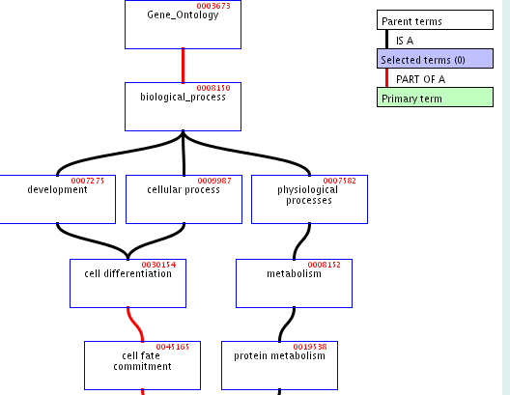

Slide 29
Uses of multiple inheritance associated with errors in coding
B C
is-a₁ is-a₂
A
‘is-a’ no longer univocal

Slide 30
‘is-a’ is pressed into service to mean a variety of different things
no rules for correct coding
ambiguities serve as obstacles to integration

Slide 31
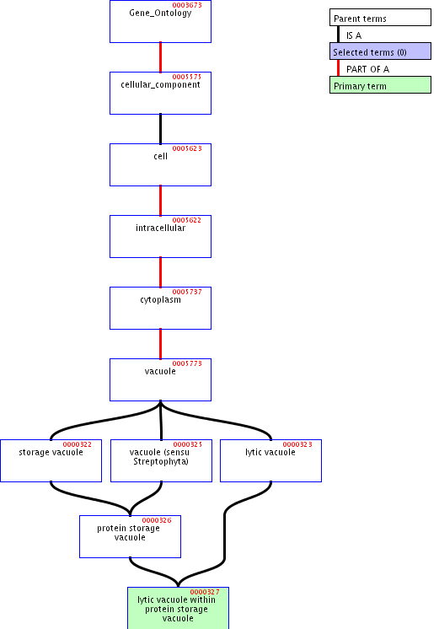

Slide 32
storage vacuole is-a vacuole
is a storage vacuole a special kind of vacuole?
is a box used for storage a special kind of box?

Slide 34
‘within’
lytic vacuole within a protein storage vacuole
lytic vacuole within a protein storage vacuole is-a protein storage vacuole
time-out within a baseball game is-a baseball game
embryo within a uterus is-a uterus

Slide 35
Problems with Location
is-located-at / is-located-in and similar relations need to be expressed in GO via some combination of ‘is-a’ and ‘part-of’
… is-a unlocalized
… is-a site of …
is-a … within …
etc.

Slide 36
Problems with location
extrinsic to membrane part-of membrane

Slide 37
Old GO: part-of = can be part of
GO 0005634: nucleus part-of GO 0005622: cell

Slide 38
Old GO: Three meanings of ‘part-of ’
‘part-of’ = ‘can be part of’ (flagellum part-of cell)
‘part-of’ = ‘is sometimes part of’ (replication fork part-of the nucleoplasm)
‘part-of’ = ‘is included as a sublist in’

Slide 39
New GO:
part-of = is necessarily part of
larval fat body development
is necessarily part-of
larval development (sensu Insecta)
(seems wrong)

Slide 40
Part Three
GO and Life Science Data Integration

Slide 41
GO’s three ontologies are separate
molecular functions
biological processes
No links or edges defined between them
cellular components

Slide 42
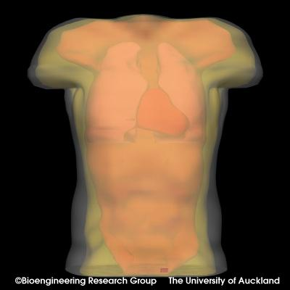
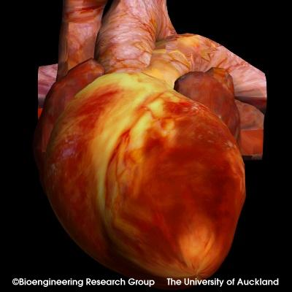
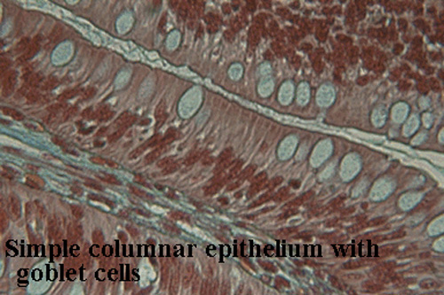
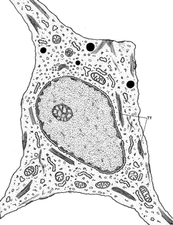
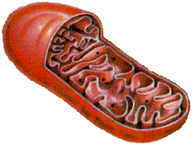
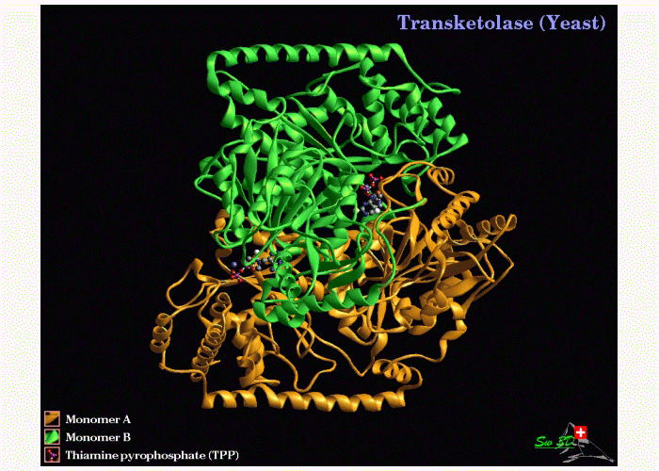
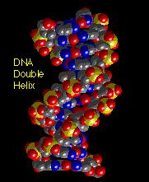
Granularity
Organism
Organ
Tissue
10⁻¹ m
Cell
Organelle
10⁻⁵ m
Protein
DNA
10⁻⁹ m

Slide 43
Three granularities:
Molecular (for ‘functions’)
Cellular (for components)
Whole organism (for processes)

Slide 44
GO has cells
but it does not include terms for molecules or organisms within any of its three ontologies
except when it makes mistakes,
e.g. GO:0018995 host
=Df Any organism in which another organism spends part or all of its life cycle

Slide 45
Granularity
Organism
Organ
Tissue
10⁻¹ m
Cell
Organelle
10⁻⁵ m
Protein
DNA
10⁻⁹ m

Slide 46
GO’s three ontologies are in fact four
cellular
processes
organism-level
biological processes
molecular functions
cellular components

Slide 47
molecular functions
cellular
processes
organism-level
biological processes
molecule
complexes
cellular components
organisms
‘part-of’; ‘is dependent on’

Slide 48
molecular functions
cellular
processes
organism-level
biological processes
molecule
complexes
cellular components
organisms

Slide 49
molecular processes
cellular
processes
organism-level
biological processes
molecular functions
cellular
functions
organism-level
biological functions
molecule
complexes
cellular components
organisms

Slide 50
Human beings know what ‘walking’ means
Human beings know that adults are older than embryos
GO needs to be linked to ontology of development
and in general to resources for reasoning about time and change

Slide 51
but such linkages are possible
only if GO itself has a coherent formal architecture

Slide 53
Is this just philosophy ?

Slide 54
Human consequences of inconsistent and/or indeterminate use of syntactic operators
29% of GO’s contain one or more problematic syntactic operators
but these terms are used in only 14% of annotations

Slide 55
Computational consequences
much information not available for purposes of automatic information retrieval

Slide 56
Inconsistent use of ‘is-a’ and ‘part-of’
1. leads to coding errors → constant updating
2. makes it unclear what kinds of reasoning are permissible on the basis of GO’s hierarchies
3. creates obstacles to ontology alignment and thus also to data integration

Slide 57
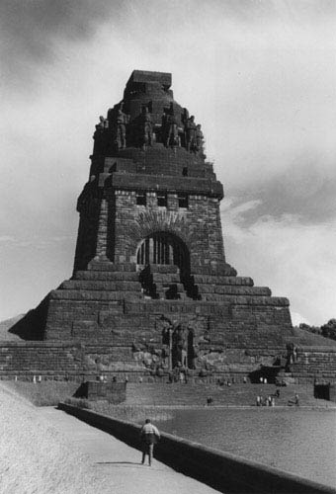
The End
Workshop: The Formal Architecture of the Gene Ontology
Leipzig, May 28-29
Guest Speaker: Michael Ashburner
http://ifomis.de

